Slide 1
TrashCan Productions
Filipa Ivanković, Ivo Ivanković & Saelda Rrahi
Quiz Quest

Slide 2
Quiz Quest contents
A text-based 2 player multyplayer game
16 board spaces
Objective: Reach the end goal (16th space), while answering a bunch of stupid, silly and downright absurd questions that lead to different scenarios/outcomes
A fun/annoying game

Slide 3


Two player game
Player 1
Player 2

Slide 4
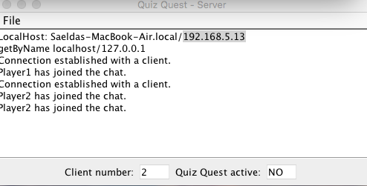
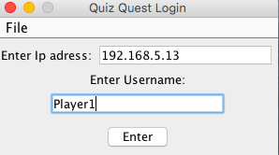
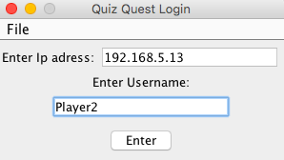
Start SERVER AND Clients
Server
Login Player1
Login Player2

Slide 5
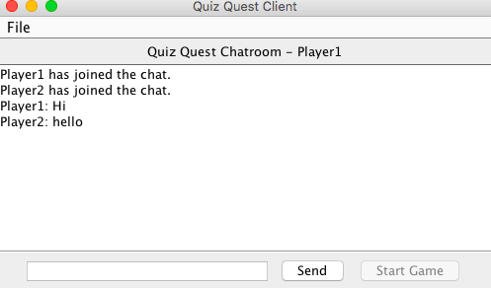
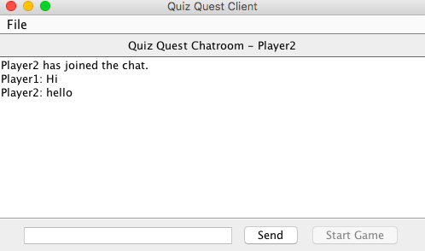
Chat Between players
Send message to Player 2
Send message to Player1

Slide 6
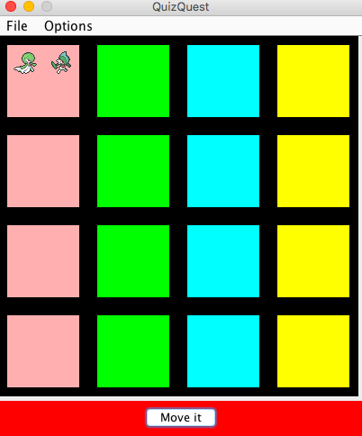
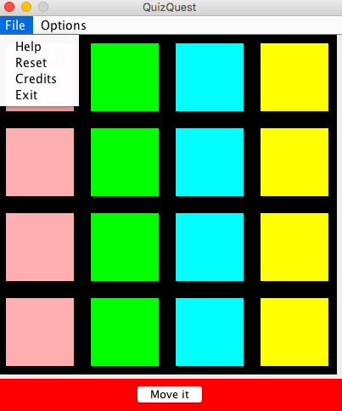
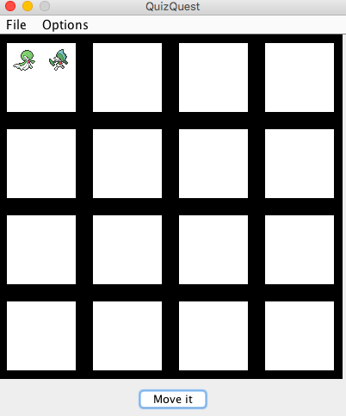
Start Game
Turn on Colors
Information about game
Turn off Colors

Slide 7
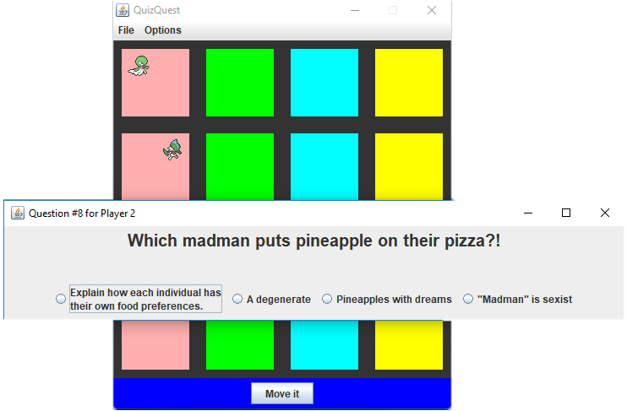
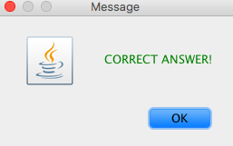
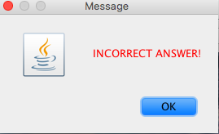
Start PLAYING GAME
MOVE 2 additional
spaces
Go back one step
CLICK MOVE IT TO START WITH QUESTIONS

Slide 8
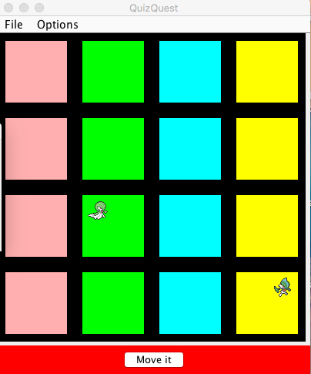
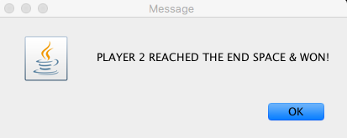
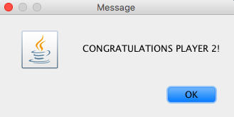
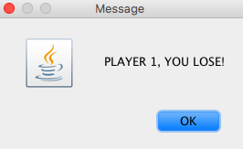
WINNER?!
Player1
Player2

Slide 9
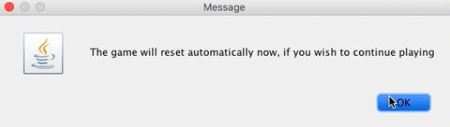
Reset game

Slide 10
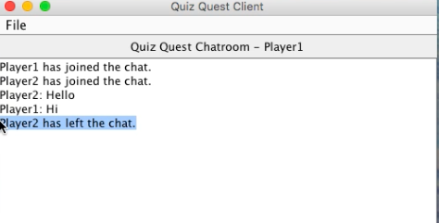
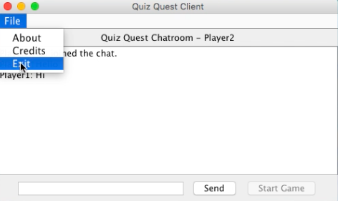
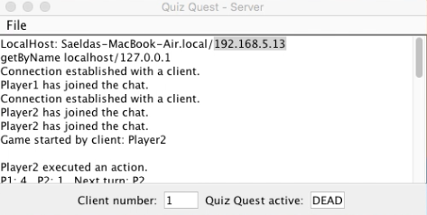
Exit clients from connection
Player 2 has left from chat

Slide 11

any questions?

Slide 12


Thank you
For you attention!

